Slide 1
Brick Wall Target
European New Car Assessment Programme
Euro NCAP

Slide 2
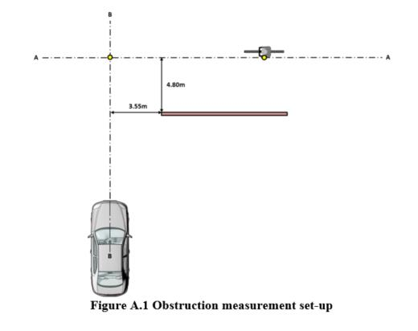
Euro NCAP protocol
Height of the obstruction ≥ 2.00m
Width of the obstruction ≥ 0.05 and ≤ 0.50m
Length of the obstruction ≥ 8.50m

Slide 3
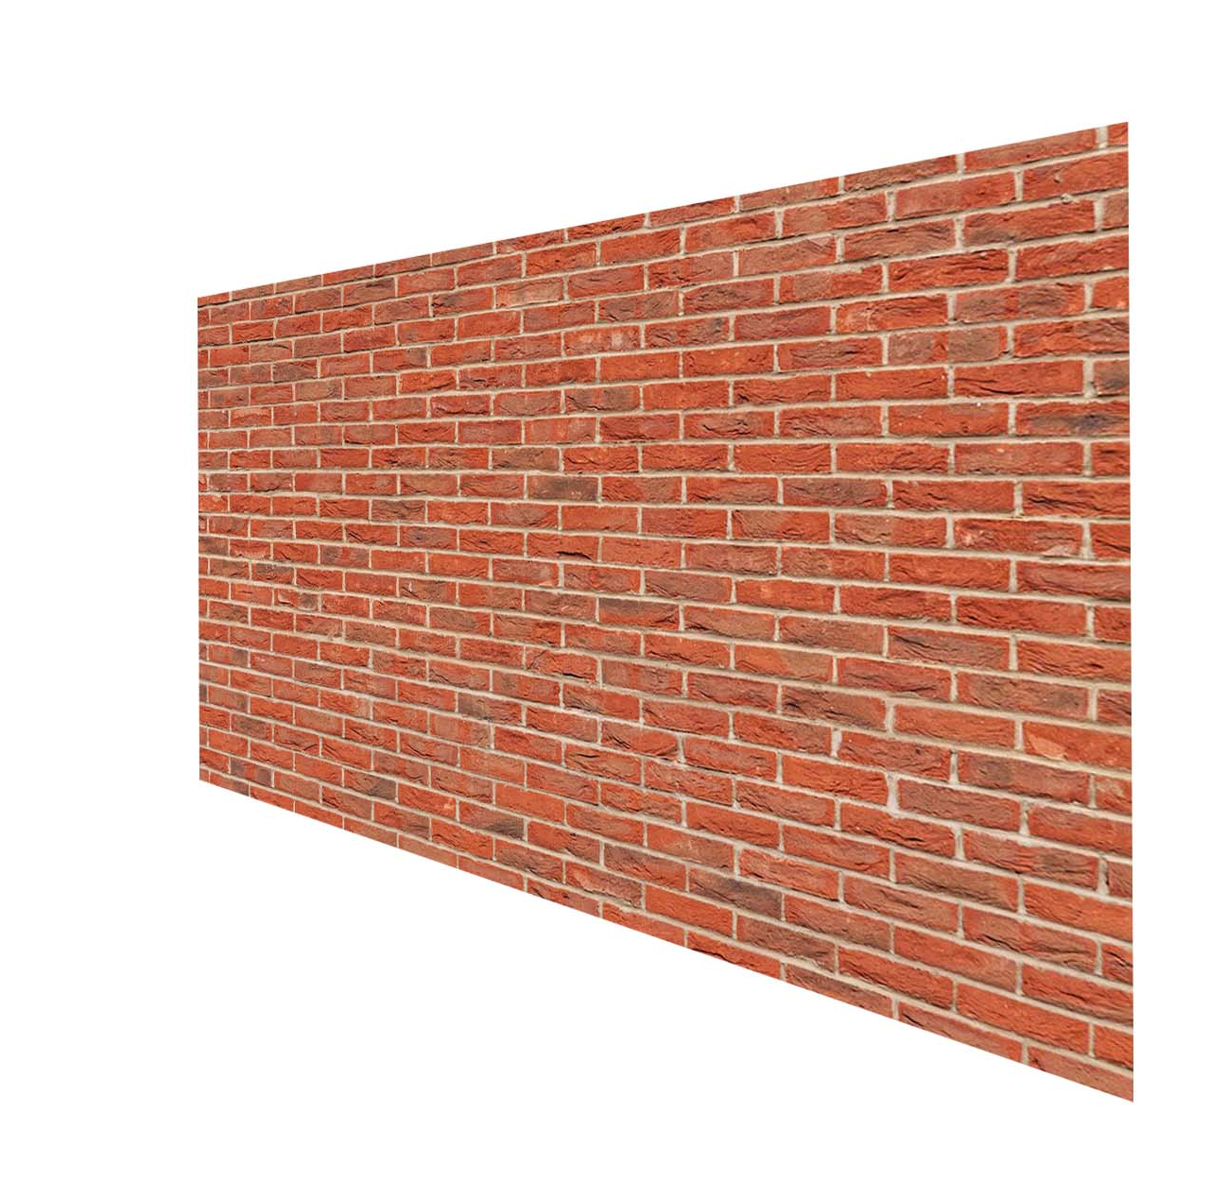
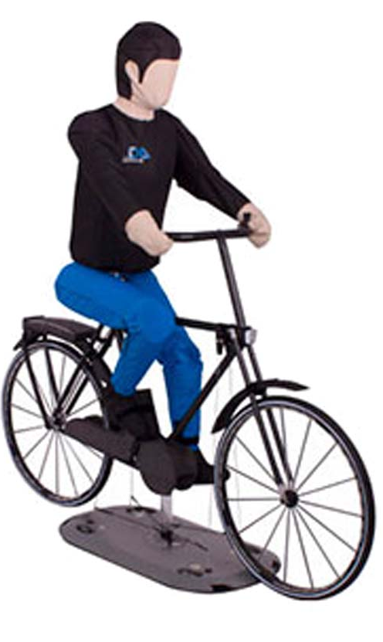
Section 1 of 4 Brick wall target
Here is our first section of the 8.8 meters long Foam Brick wall Target. Being modular in 4x 2.2m lengths, in various combinations can be achieved.
The default brick wall image can replaced with any custom printed image.

Slide 4
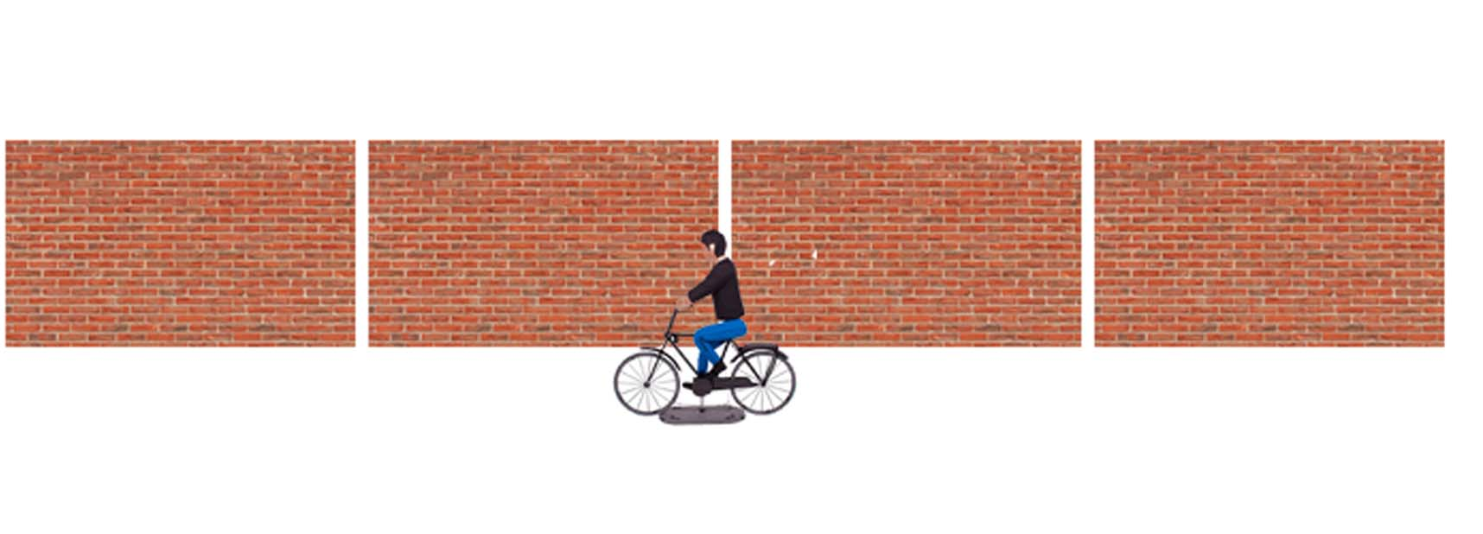
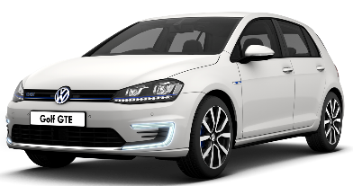

Slide 5
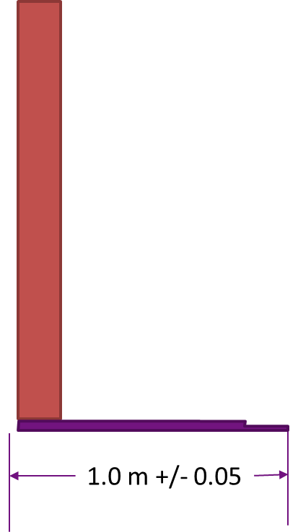
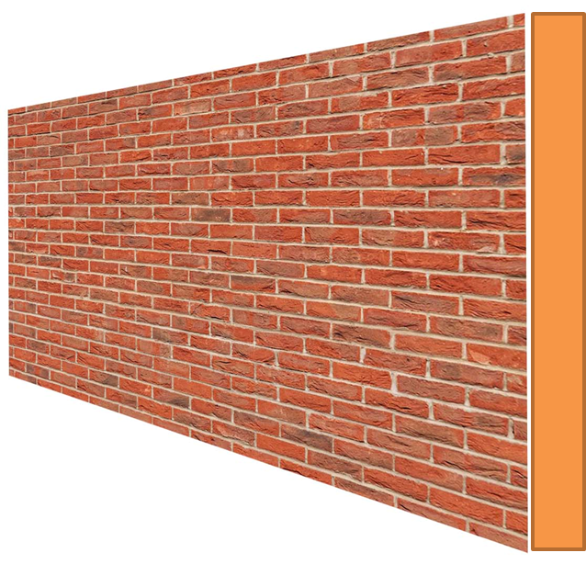
Nylon base for stability
The wall will come in sections of 4 with each sections at a length of 2.2meters x 2meters High and between 10-15cm Depth on the Foam Target.
It will be free standing on a weighted plastic base.
The image is customizable

Slide 6
Thank-you!

