Slide 1
IIHS Headlight test - NEST concept

Slide 2
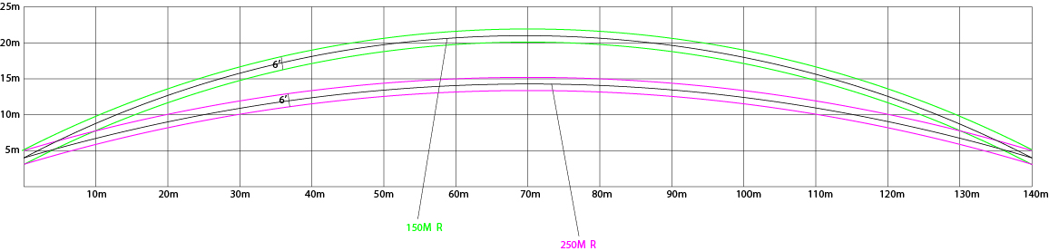
IIHS Headlight test - NEST concept
Document reference: Headlight Test and Rating Protocol (Version II) – November 2016
http://www.iihs.org/iihs/ratings/technical-information/technical-protocols

Slide 3
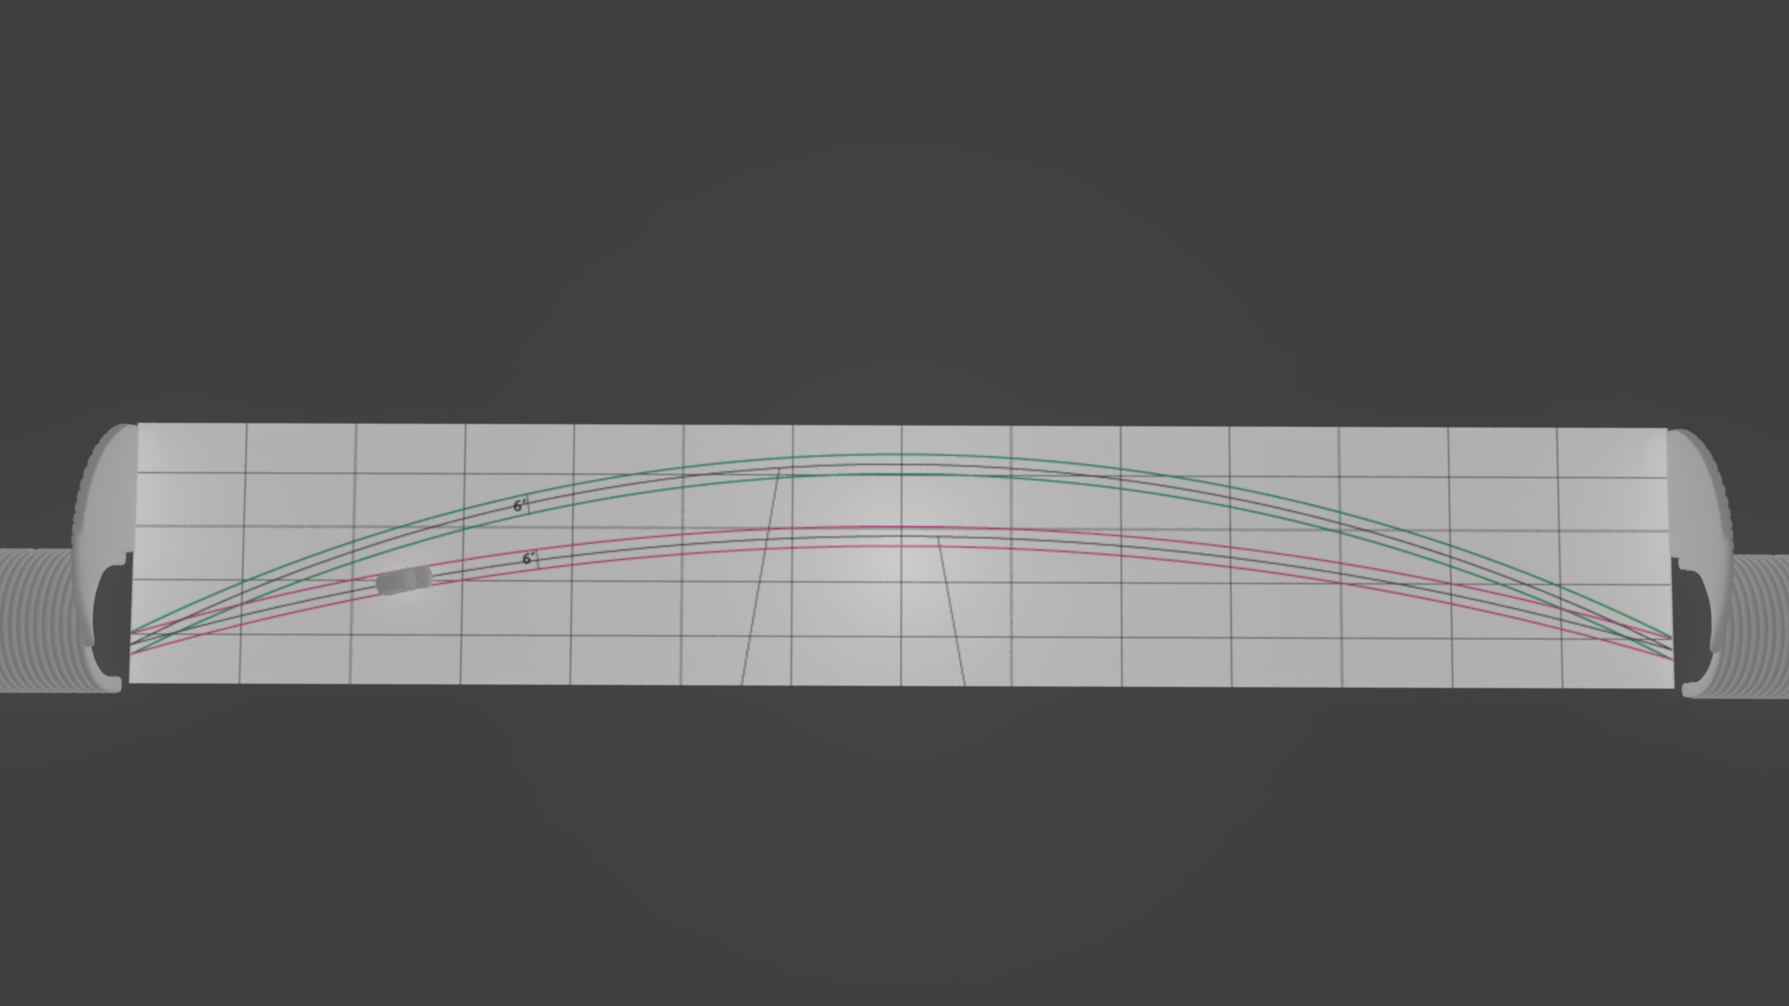
IIHS Headlight test - NEST concept

Slide 4
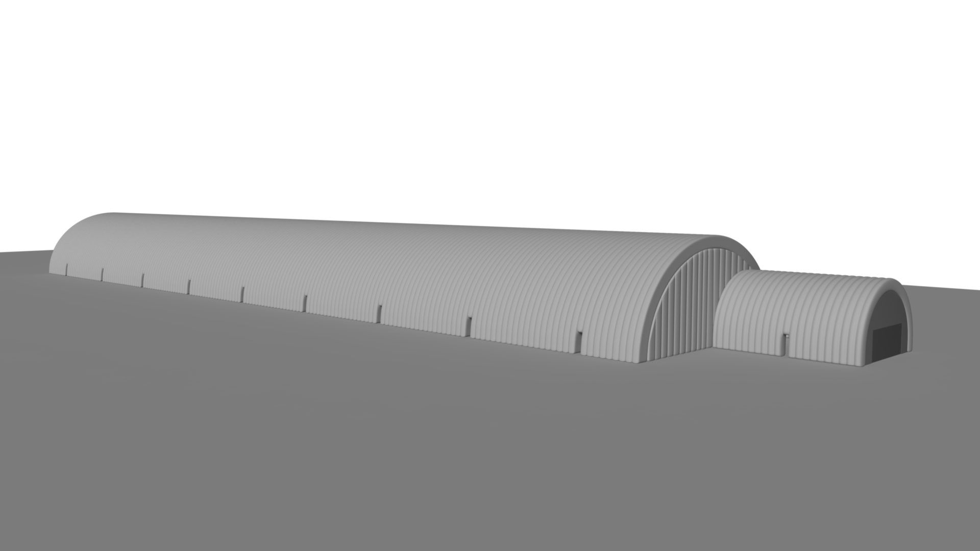
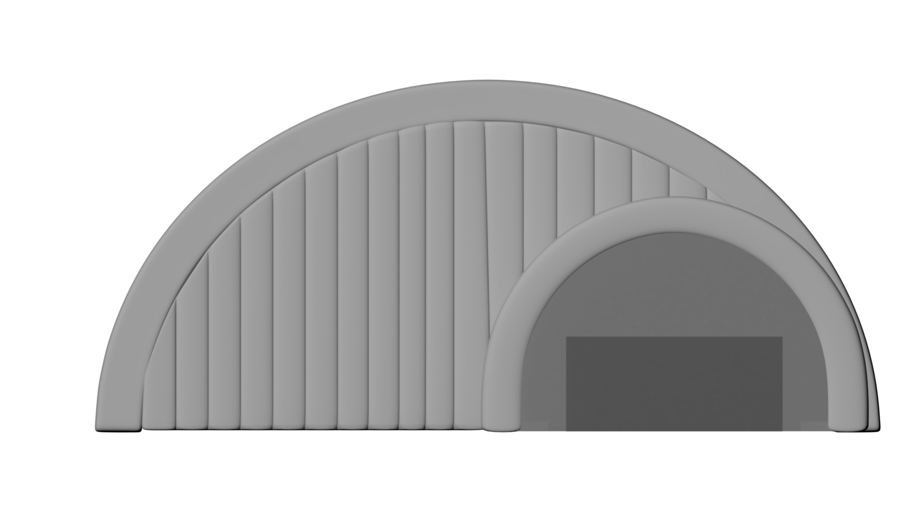
IIHS Headlight test - NEST concept

Slide 5
IIHS Headlight test - NEST concept

Slide 6
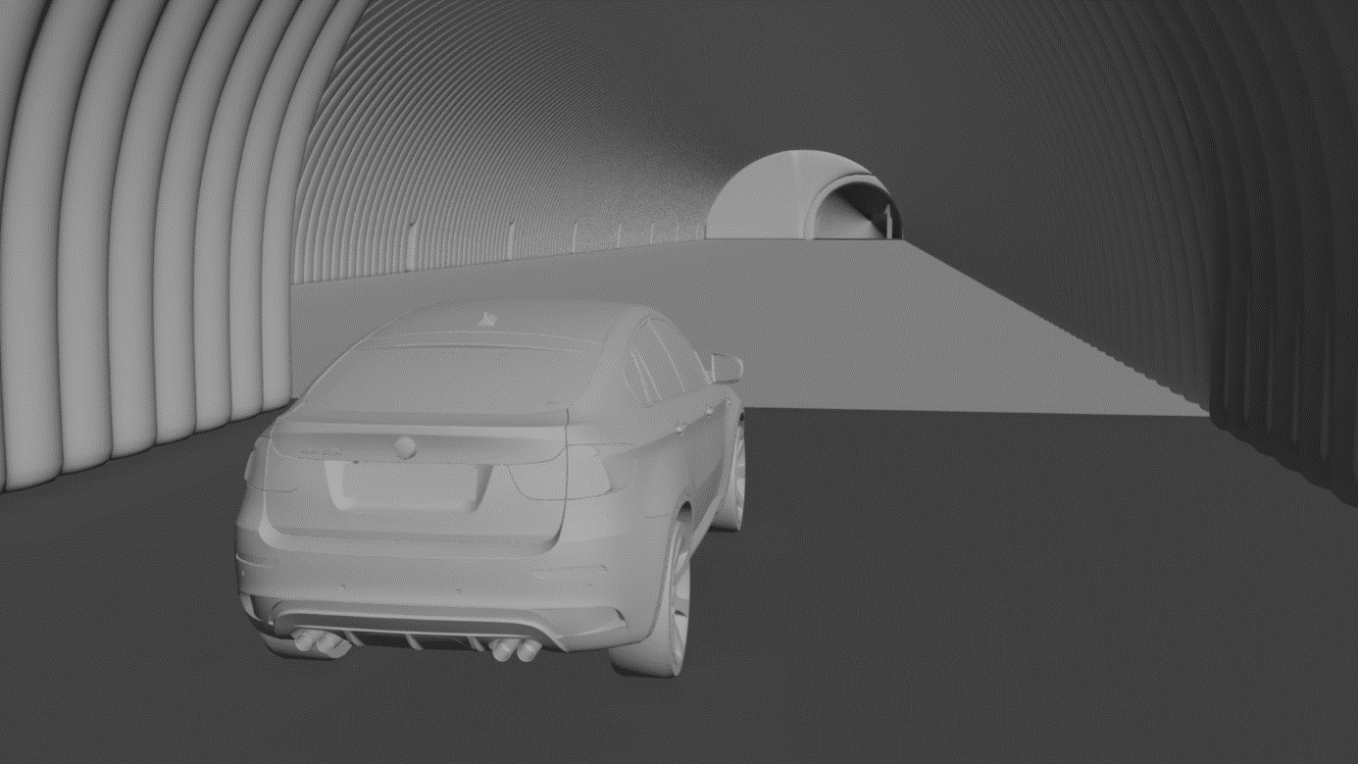
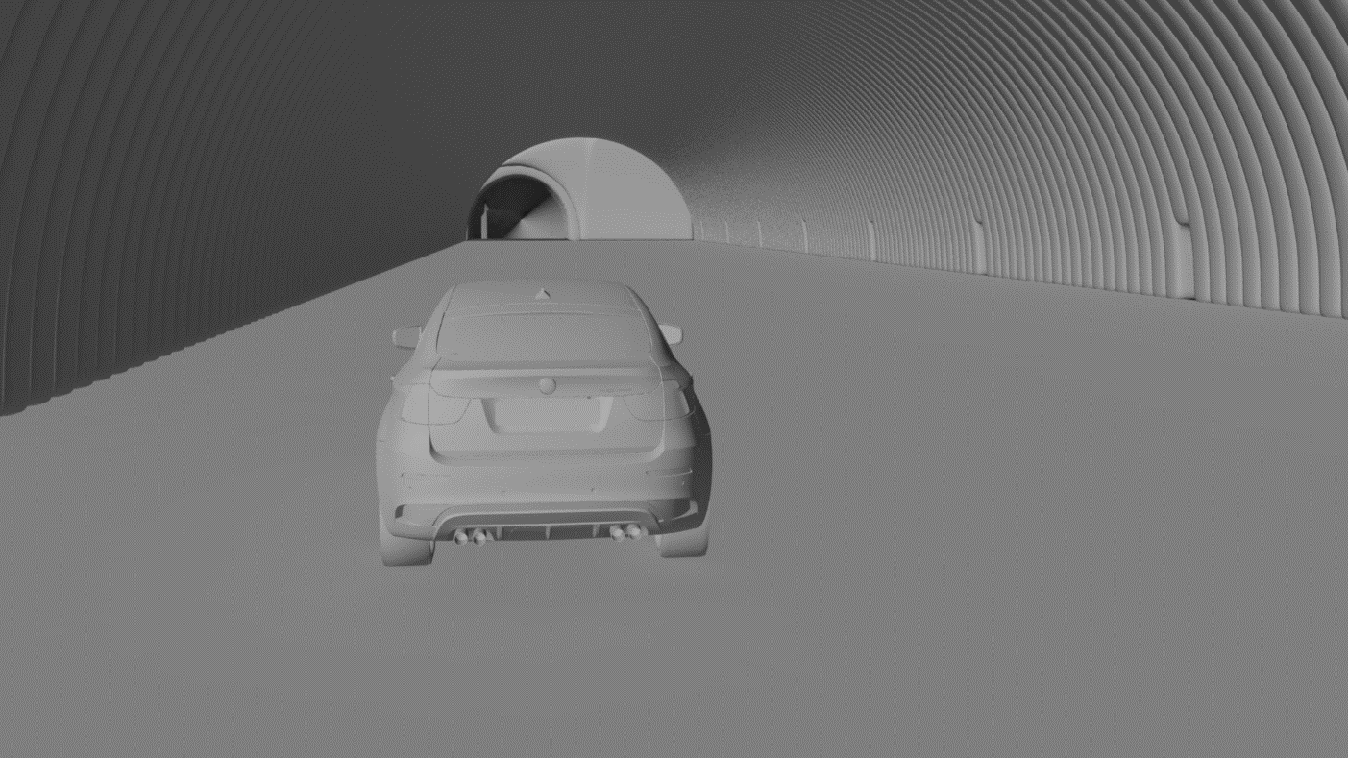
IIHS Headlight test - NEST concept

Slide 7
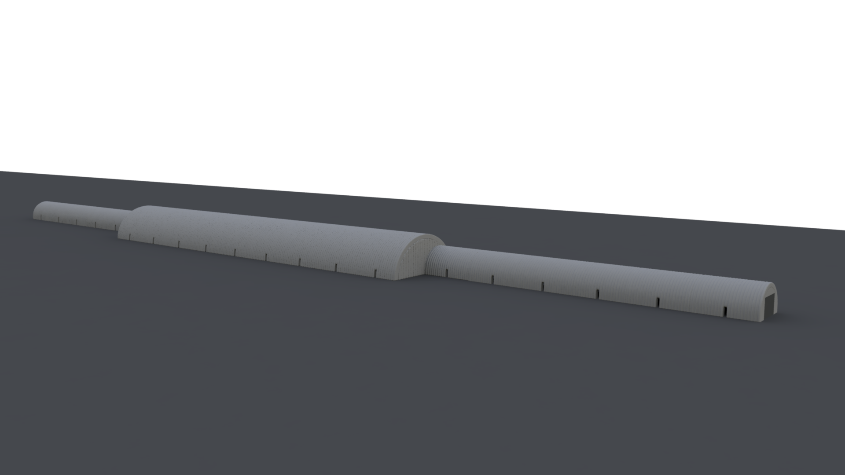
IIHS Headlight test - NEST concept

Slide 8

Aerial view
15 x 10 m sections Large central area 140 m x 25 m 15 x 10 m sections
Drive through…

Slide 9
Thank you

